Slide 1
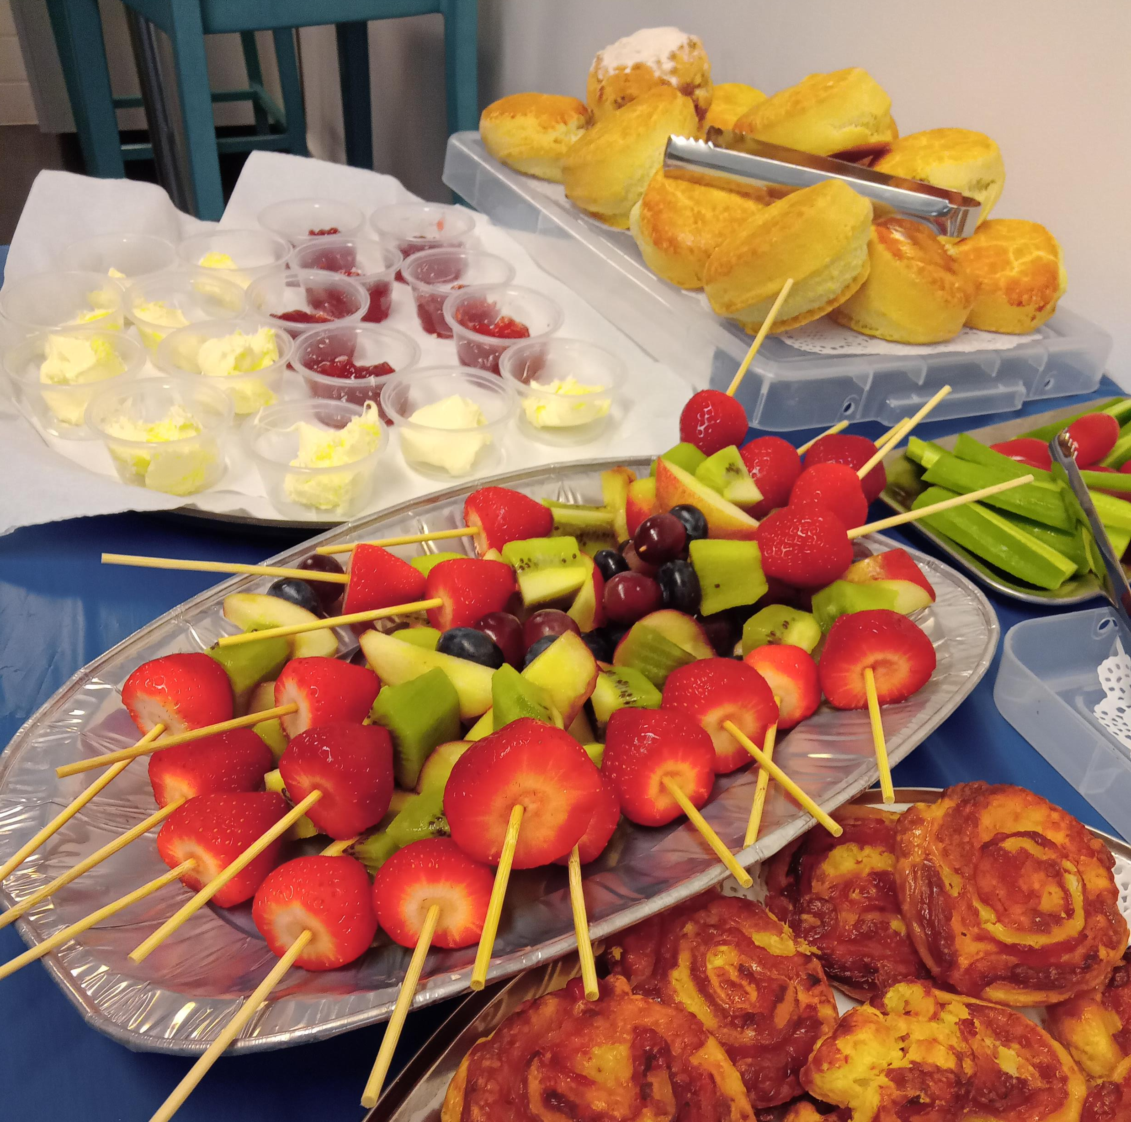
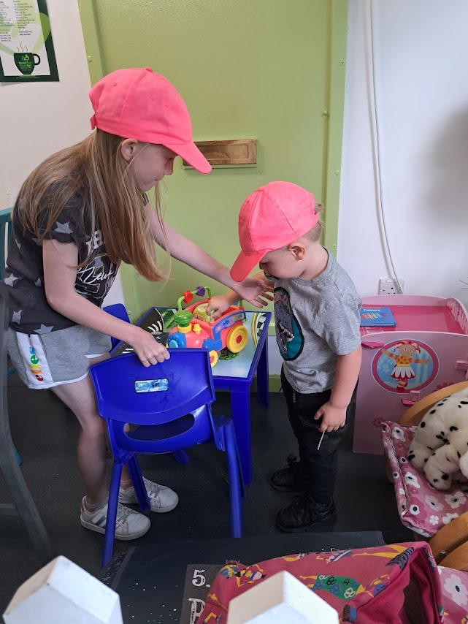
Half-Term Fun in the shop!
Weekly Activities:
2nd August – Kite Making
9th August – Art & Craft with Nicola
16th August – Smoothie Making
23rd August – Pizza Making
30th August – Grow your own Vegetables
Let us entertain the children while you enjoy a coffee and a natter with a friend
Free buffet lunch

